Slide 1
Analysing the distribution of greek restaurants
In the center of Mannheim, Germany

Slide 2
approach
Scrape location dara via Foursquare API
Paradeplatz, Mannheim as center
Investigation: radius of 2000 m around center
→ goal: find spots of low density of greek restaurants

Slide 3
findings
Currently four greek restaurants
Two clusters:
Two restaurants < 250 m
Two restaurants > 1400 m
Possible spots in an area
> 250 m & < 880 m
around the center

Slide 4
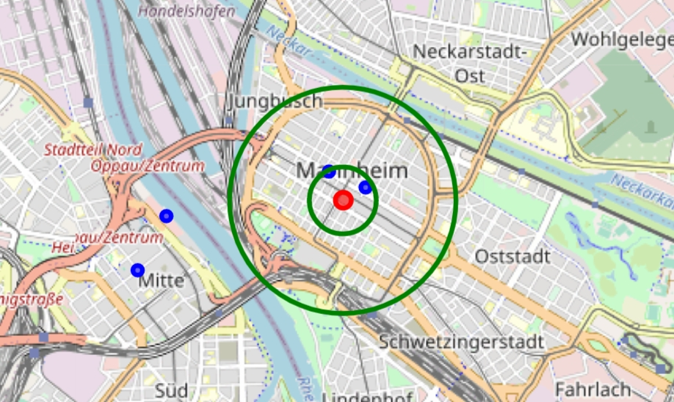
red marker: center of Mannheim (Paradeplatz), blue markers: current greek restaurants Possible spots within green circles Recommendation: a spot southly of Paradeplatz

